Slide 1


Higgs boson decays to WW at CMS
Rebeca Gonzalez Suarez
University of Nebraska, Lincoln

Slide 2
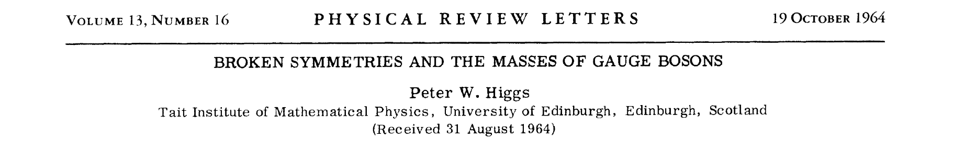
Introduction
The Electroweak symmetry breaking did not get an experimentally proved answer until 2012
The description of Electromagnetic and weak couplings at low energy is very similar → Electromagnetic: ~α, Weak: ~α/(M_{W,Z})²
The same constant is involved, but the W and Z bosons have mass (and not small, m_{W} ~80GeV, m_{Z} ~ 91 GeV, compared to m_{proton}~0.9GeV)
The Higgs mechanism (1964) provides an explanation of the EWK symmetry breaking in the Standard Model
With massive vector bosons and mass terms for the fermions
It has a side effect: an additional boson that has to be found
The mass of the boson is unknown (free parameter in the theory)
To find the Higgs boson → prove the Higgs mechanism

Slide 3
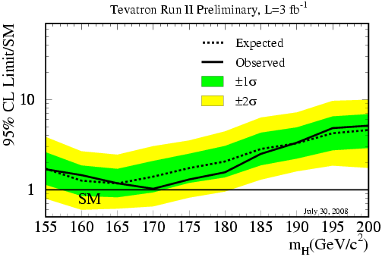
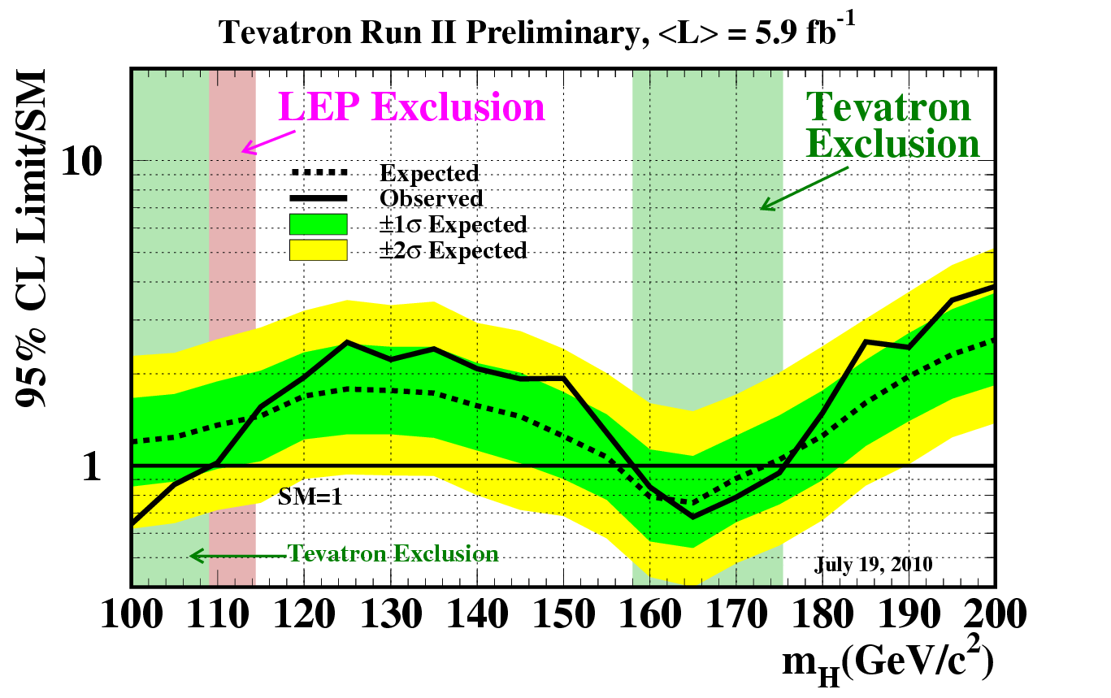
Higgs searches before the LHC
The search for the Higgs boson started way before the LHC
95% CL mass limit from LEP = 114.4 GeV
During the summer of 2008, just weeks before the first start up of the LHC, the Tevatron experiments presented their first exclusion limits:
And by the time the Run-1 started, the Tevatron had excluded a good part of the spectra around 160GeV
Summer 2008
Summer 2010

Slide 4
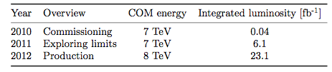
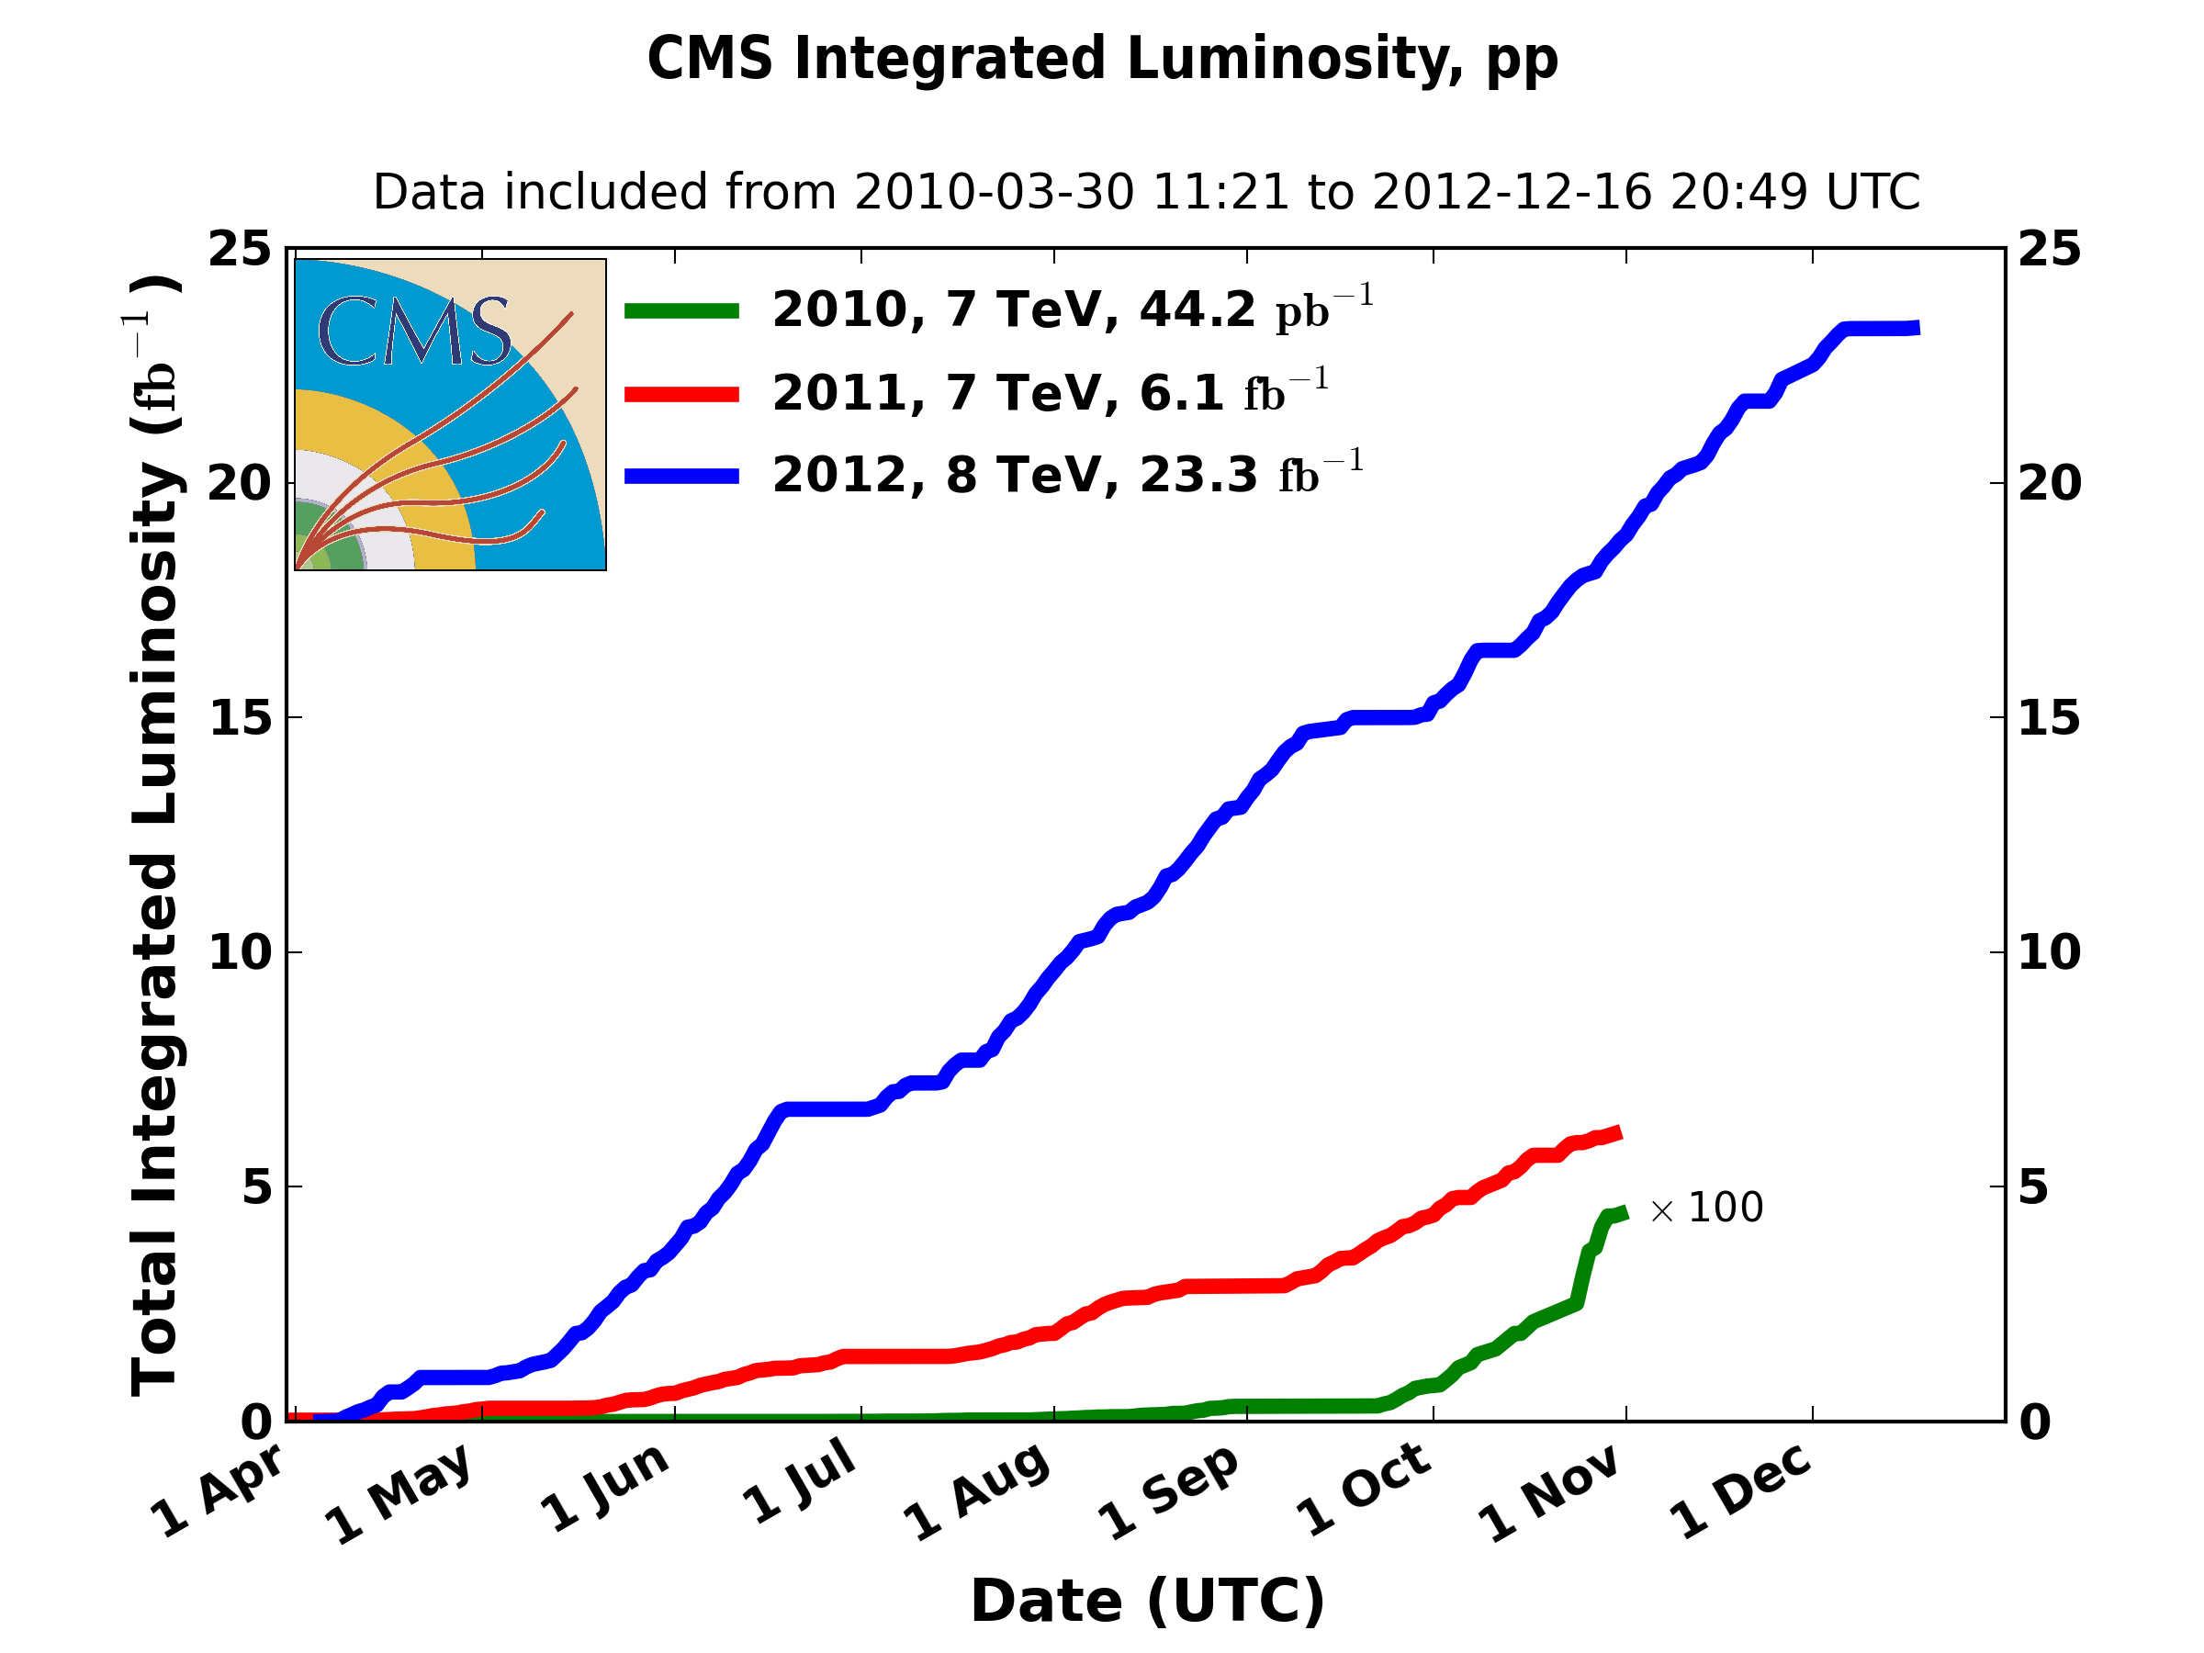
The Run-1 of the LHC
The Run-1 of the LHC ended in February 2013
It lasted three years
CMS recorded ~5fb⁻¹ of pp collisions at 7TeV and ~20fb⁻¹ at 8TeV
Main result from Run-I:
Higgs discovery

Slide 5

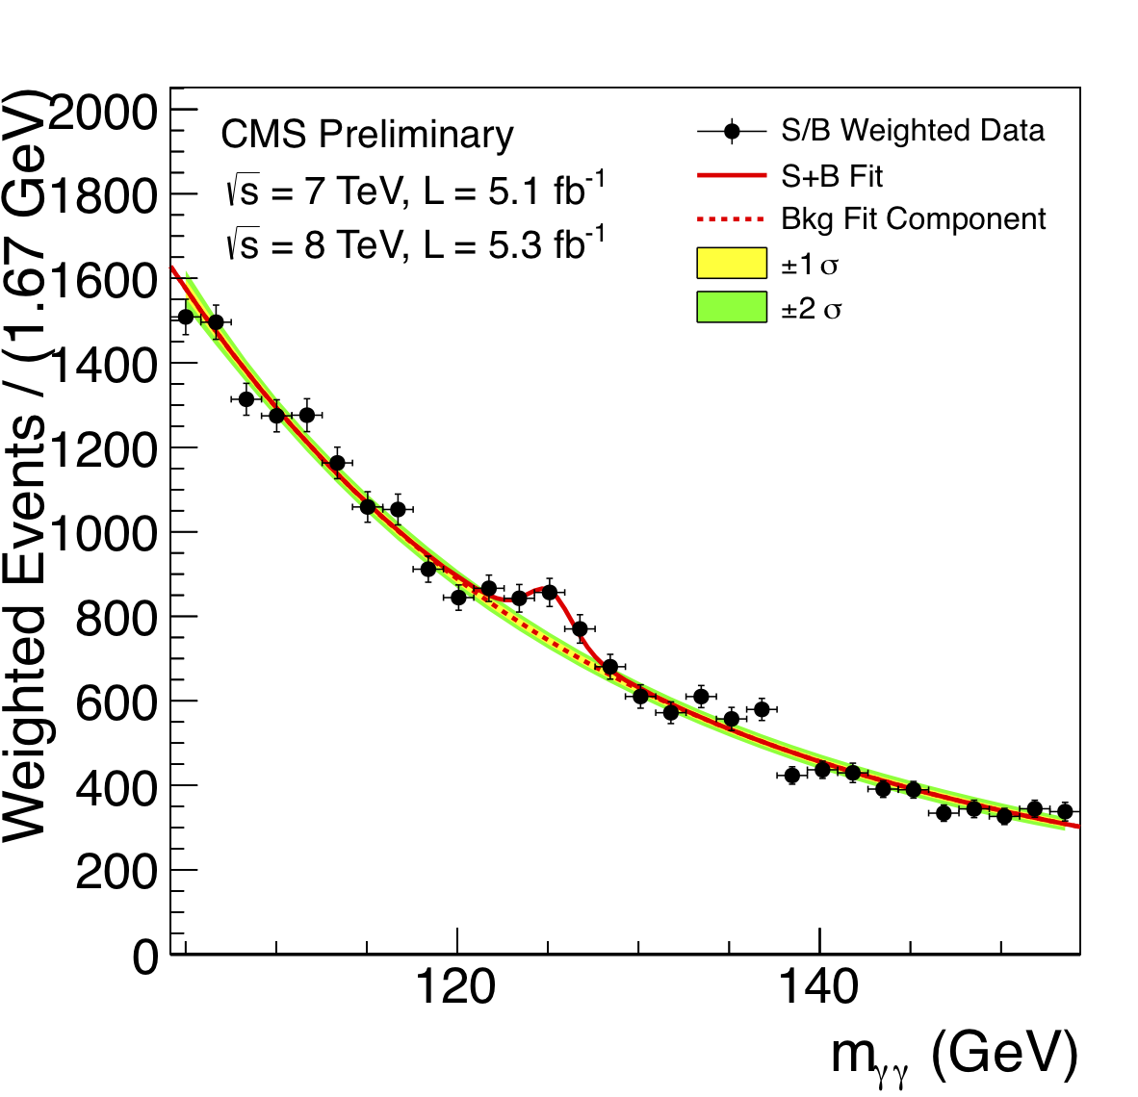
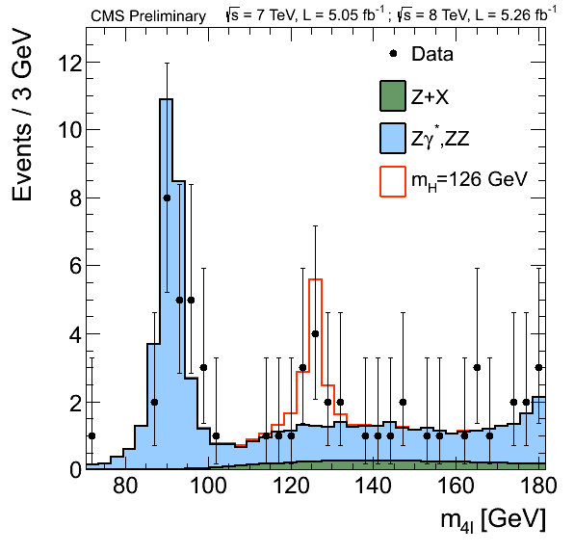
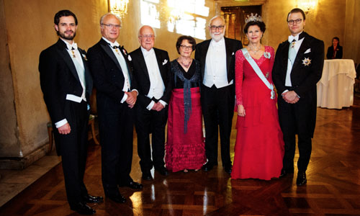

Higgs searches at the LHC
arXiv:1207.7235
Phys. Lett. B 716 (2012) 30
(Submitted 31 July 2012)
arXiv:1303.4571
JHEP 06 (2013) 081
(Submitted 19 March 2013)
CMS discovery papers

Slide 6
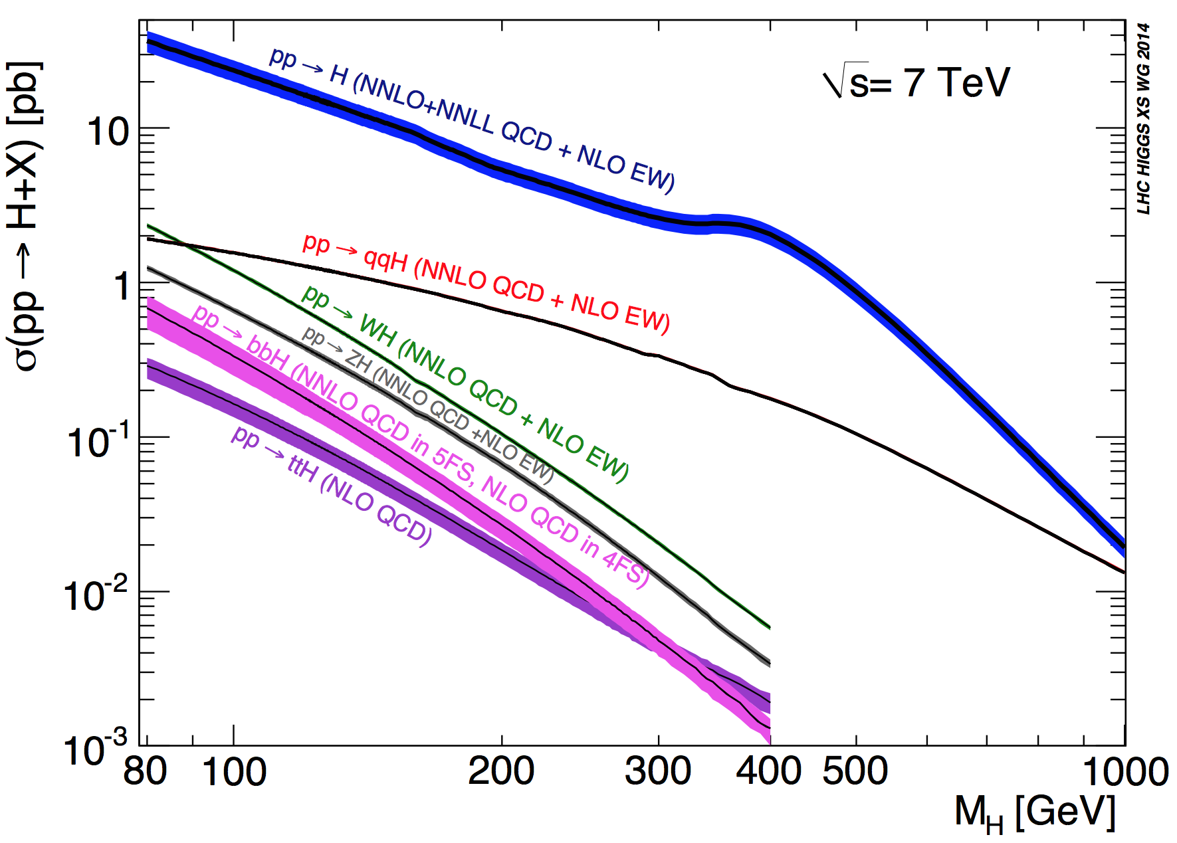
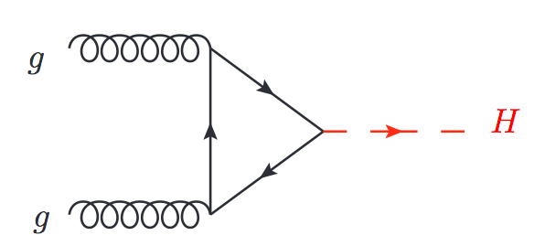
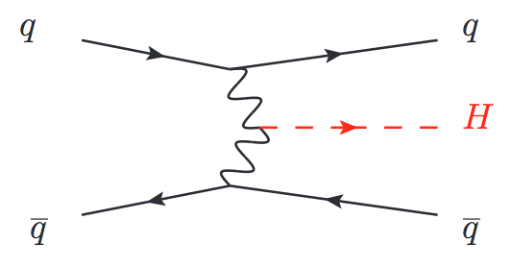
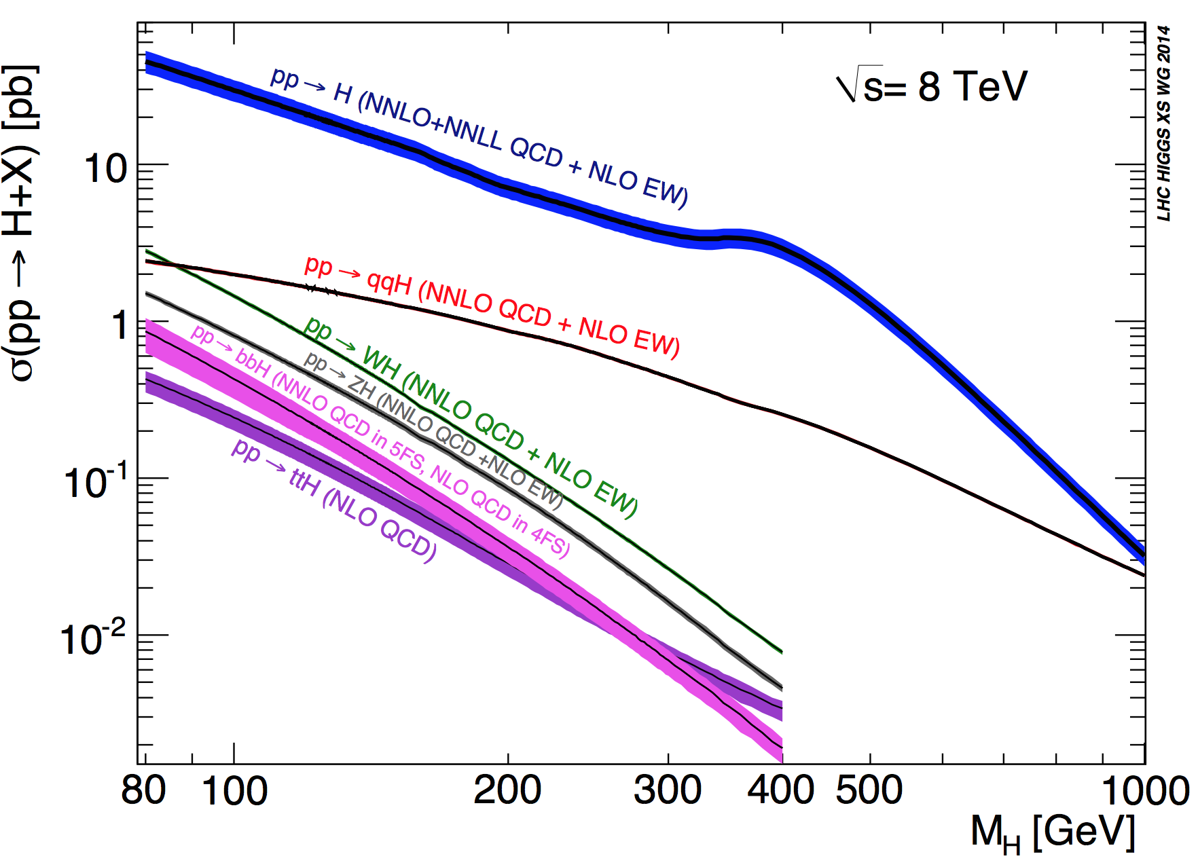
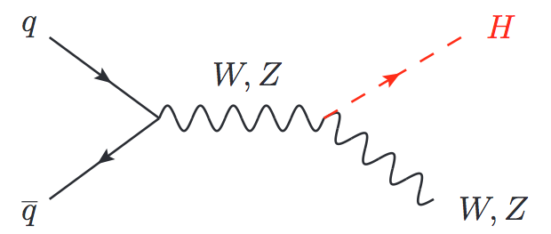
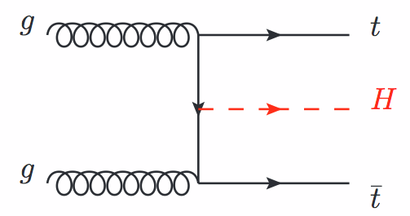
Higgs production at the LHC
The first thing to consider when searching for the Higgs boson is the production mode
Gluon-gluon fusion (ggH)
No hadronic activity
Vector Boson Fusion (VBF) 2 forward jets
Associated production with a W or a Z boson (WH,ZH)
Associated production with a top/anti-top pair (ttH)

Slide 7
How many where produced?
For a mass of m_{H} = 125GeV
 | 7TeV |  | 8TeV |  | Total events
 | σ [pb] | # events | σ [pb] | # events
ggH | 15.13 | 74137 | 19.27 | 373838 | 447975
VBF | 1.22 | 5978 | 1.578 | 30613.2 | 36591.2
WH | 0.5785 | 2834.65 | 0.7046 | 13669.24 | 16503.89
ZH | 0.3351 | 1641.99 | 0.4153 | 8056.82 | 9698.81
ttH | 0.08632 | 422.968 | 0.1293 | 2508.42 | 2931.388
Total: |  |  |  |  | 513700.288
During the Run-I, the LHC delivered ~0.5M of Higgs bosons, most of them (87%) via gluon gluon fusion
Do we see them all?

Slide 8
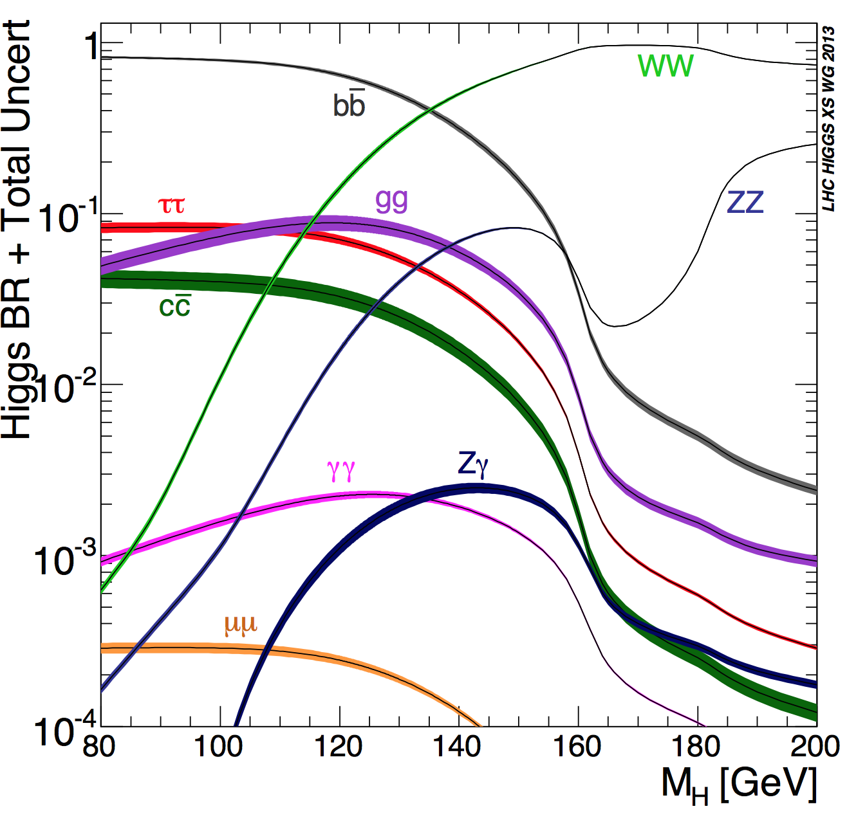
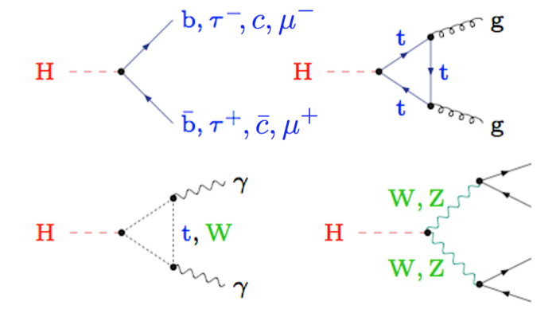
Higgs decay channels
The observation of the Higgs also depends on its decay mode
Discovery mode → balance between Branching Ratio, clear experimental signature, and background contributions
H→ZZ→4l
Very clean experimental signature
H→γγ
Mass peak reconstruction
H→WW→2l
Clear experimental signature, no mass peak
H→ ττ
Accessible via VBF
H→ bb
Highest BR for low masses. Challenging experimentally

Slide 9
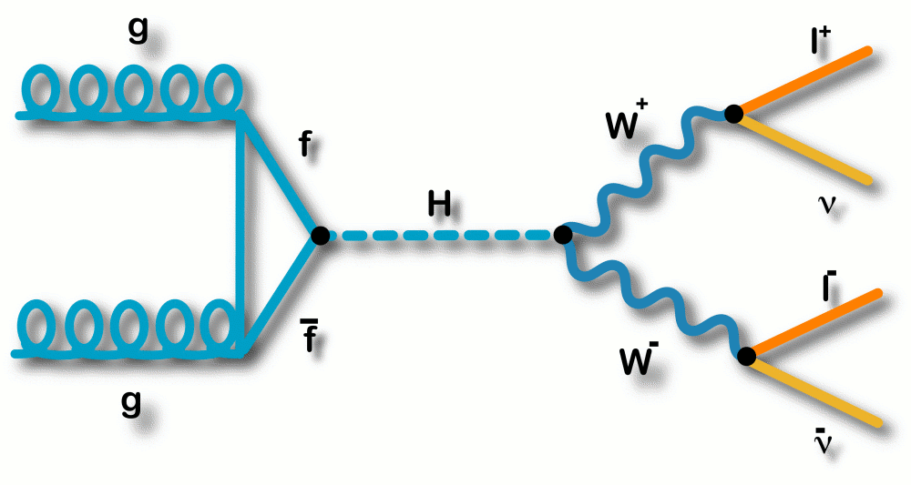
Why H→WW?
Sensitive in the intermediate mass range [120-200]
2^{d} largest BR around 125 GeV → BR _{H→WW} ~ 22%
Clear signature in leptonic decays (BR_{W→lν} ~ 10%)
Not possible to reconstruct full final state due to the neutrinos, no mass peak
Large background contribution (genuine and instrumental)
WW (irreducible), top, Drell-Yan, W+jets, QCD…
Two isolated leptons (e,µ) with opposite charge
Substantial missing energy (two neutrinos)
Depending on the production mode
ggH → little to no jet activity
VBF has 2 forward jets
+ other production modes (VH, ttH) provide even
more specific signatures (not covered today)

Slide 10
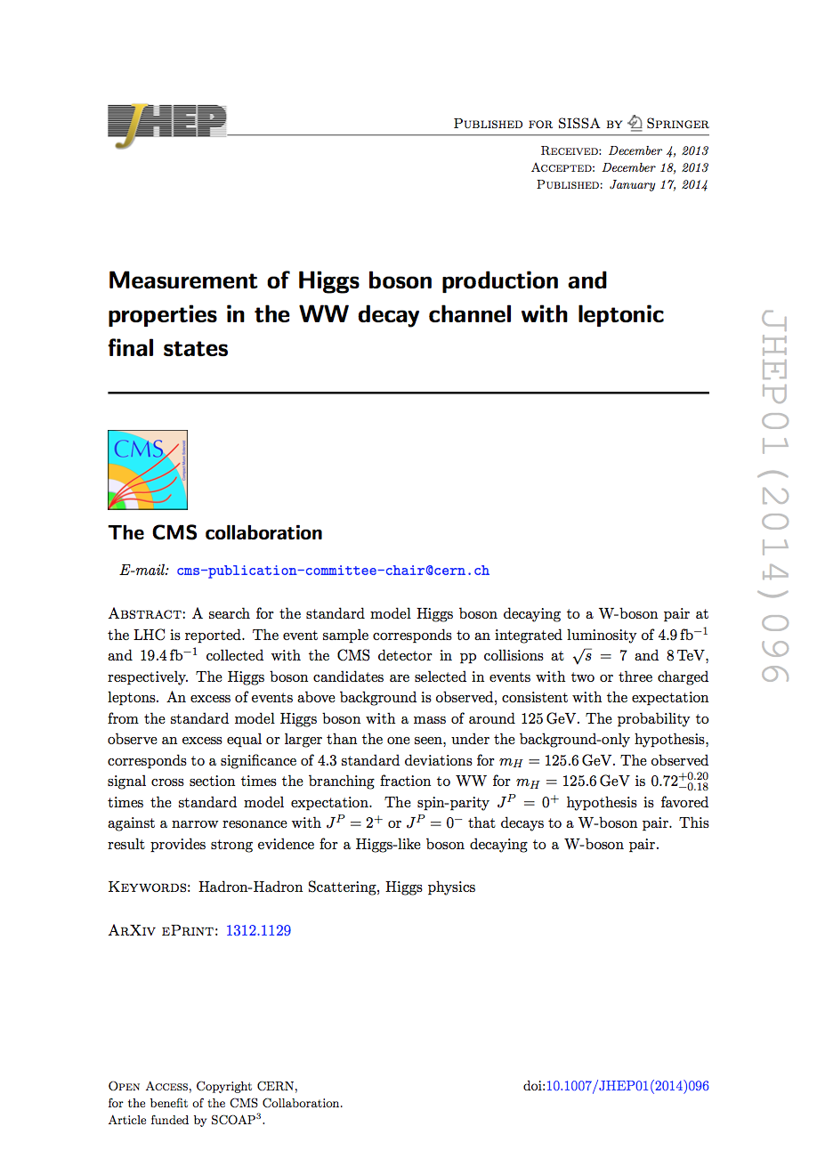
Legacy publication
The final Run-1 word from CMS in this decay channel uses the full dataset at 7 and 8 TeV and was published in JHEP in January last year:
Several processes were studied in detail, ggH, VBF, WH, ZH in 2 and 3 leptons signatures
The main analysis, that drives the sensitivity for this decay, is the, H→WW→eνµν in events with 0/1-jets (gg), and it is the one that we will discuss in this presentation
H→WW legacy paper
arXiv:1312.1129
JHEP 01 (2014) 096

Slide 11
Physics Objects
Events are selected using single and double lepton triggers
Single: e 17-27 GeV µ 17-24 GeV
Double (ee,eµ,µµ): 17, 8 GeV
The analysis uses leptons, missing transverse energy, jets and b-jet identification
Leptons
Backgrounds without two prompt leptons (W+jets, QCD…)
Selected following specific quality criteria, isolated
Electrons |η| < 2.5
Muons |η| < 2.4
Jets
Backgrounds with high jet multiplicity or with central jets (ttbar)
Anti-k_{t} 0.5, p_{T} > 30 |η| < 4.7

Slide 12
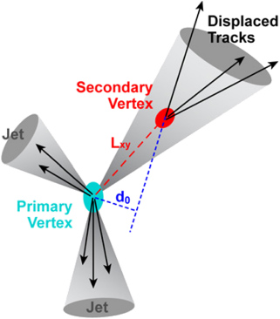
Physics Objects
b - jet identification
For jets coming from b-decays (ttbar, tW)
→ top quarks decays ~100% of times as t→Wb
Two tagging techniques, taking advantage of the properties of b-jets: B hadrons fly a few mm before decaying; and in ~40% of cases, B hadron decays include a soft lepton (e/μ) from b→l or b→c→l
b-tag algorithm based on lifetime
soft muon identification: p_{T}> 3 no isolation
rejects 70% b-quark jets, keeps 95% of light quarks

Slide 13
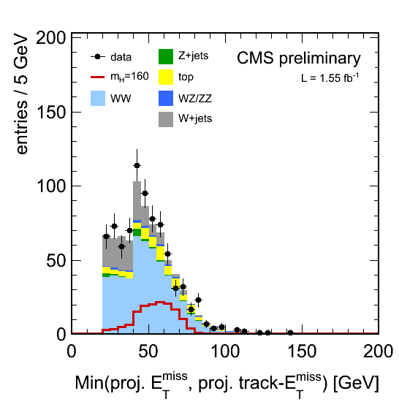
Physics Objects
Missing transverse energy (MET)
Backgrounds with no genuine MET (Drell-Yan→l⁺l⁻)
different estimators
Particle Flow MET (PF MET), which uses all CMS detector subsystems and reconstructs a full list of stable particles
Tracker MET, that uses charged particles only, and it is less dependent on pileup effects
Projected MET
MET*sin[min(π/2,ΔΦ_{MET-closest lepton})]
MET estimator: min 2 projected MET quantities, PF and Tracker MET
PAS HIG-11-014

Slide 14
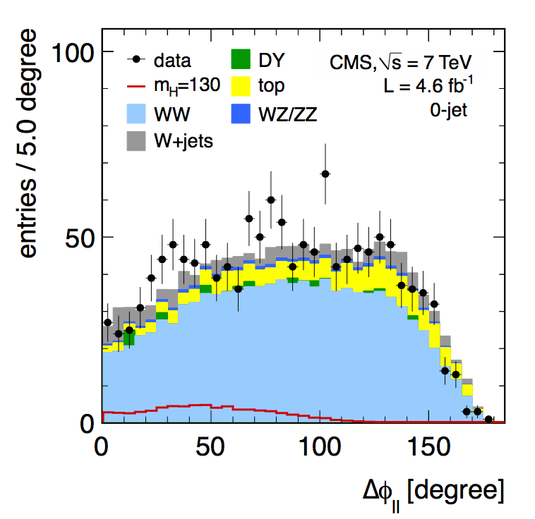
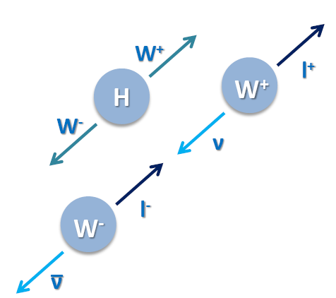
Kinematics of the signal
Some backgrounds have the exact same final state, WW→2l2ν is the clearest case and the almost irreducible one
There are three main observables to separate the signal from backgrounds:
ΔΦ_{ll}: opening angle between the two leptons in the transverse plane to the beam, correlated to the spin of the Higgs boson
7 TeV paper
data

Slide 15
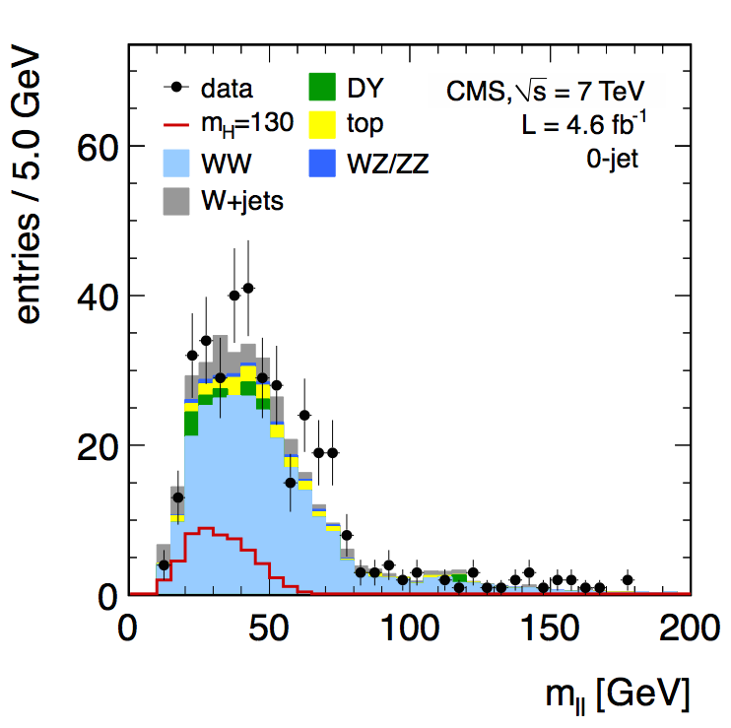
Kinematics of the signal
Some backgrounds have the exact same final state, WW→2l2ν is the clearest case and the almost irreducible one
There are three main observables to separate the signal from backgrounds:
ΔΦ_{ll}: opening angle between the two leptons in the transverse plane to the beam, correlated to the spin of the Higgs boson
m_{ll}: dilepton mass, one of the most discriminating kinematic variables for a Higgs boson with low mass, in particular against Z/γ∗→ ll
7 TeV paper eµ

Slide 16
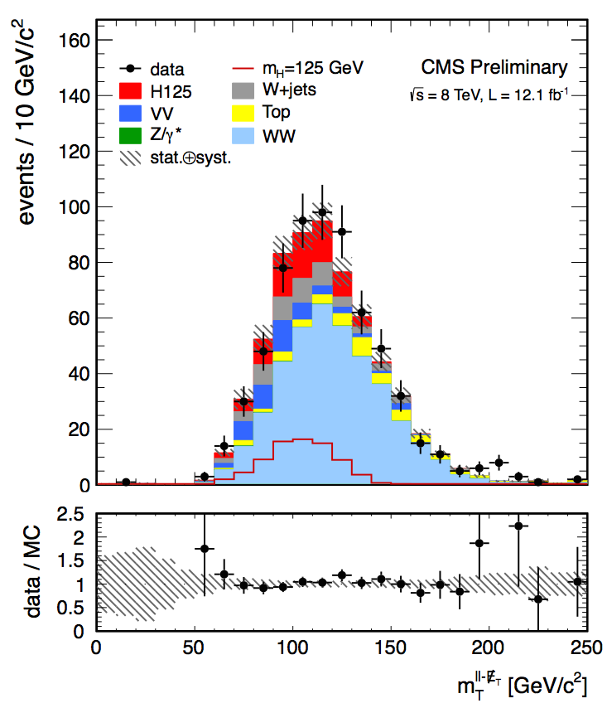
Kinematics of the signal
Some backgrounds have the exact same final state, WW→2l2ν is the clearest case and the almost irreducible one
There are three main observables to separate the signal from backgrounds:
ΔΦ_{ll}: opening angle between the two leptons in the transverse plane to the beam, correlated to the spin of the Higgs boson
m_{ll}: dilepton mass, one of the most discriminating kinematic variables for a Higgs boson with low mass, in particular against Z/γ∗→ ll
m_{T}: the transverse mass of the final state objects which scales with the Higgs mass defined here as
PAS HIG-12-042
H→WW PAS for HCP 2012

Slide 17
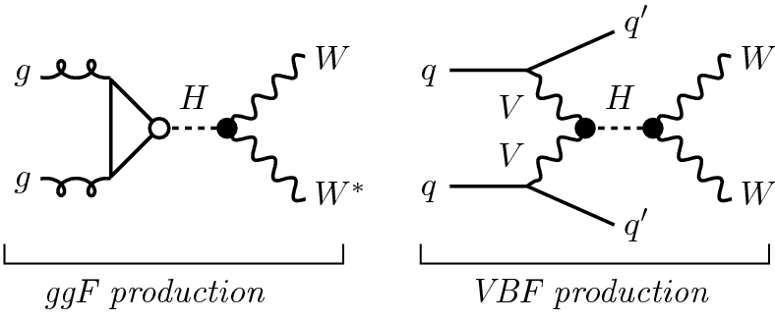
Definition of the WW selection
Exactly two leptons, eµ, with opposite charge, p_{T} > 20, 10 GeV
MET estimator > 20 GeV
Exactly 0 or exactly 1 jet
A region with: reasonable S/B and a good description of background
m_{ll} > 12 GeV
p_{T}^{ll} > 30 GeV
m_{T} > 30 GeV
Veto events with b-jets (b-tagging and soft µ)
For the same flavor (ee/µµ) case, additional cuts around the Z mass peak, and for other production modes different cuts are applied, like VBF (the second most important) that has cuts on Δη_{jj} or m_{jj}

Slide 18
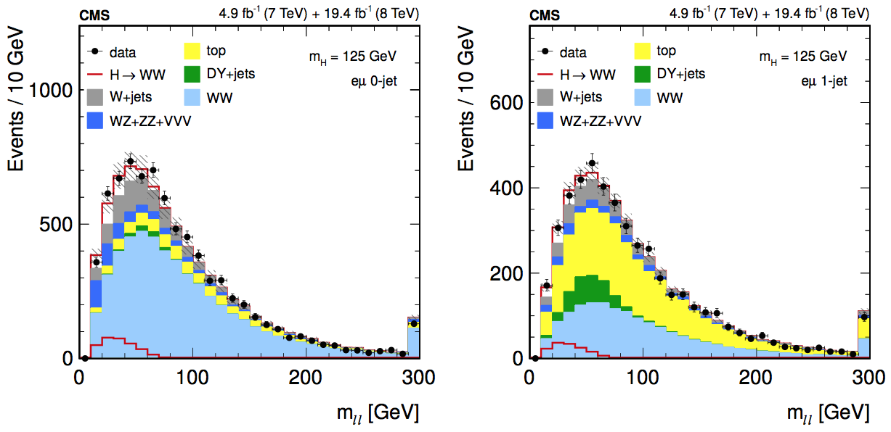
Analysis strategy
m_{ll} at the WW selection level
After the WW selection, the analysis is split in categories and has different approaches depending on the final state (e.g. cut-based for ee and µµ)
The (ggH, eµ) analysis is based on a 2D shape analysis of m_{T} - m_{ll}, with 9 bins for m_{ll}, and 14 for m_{T}
m_{ll} [12,200], m_{T} [60,280] for m_{H} <= 250 GeV
m_{ll} [12,600], m_{T} [80, 600] for m_{H} > 250 GeV

Slide 19
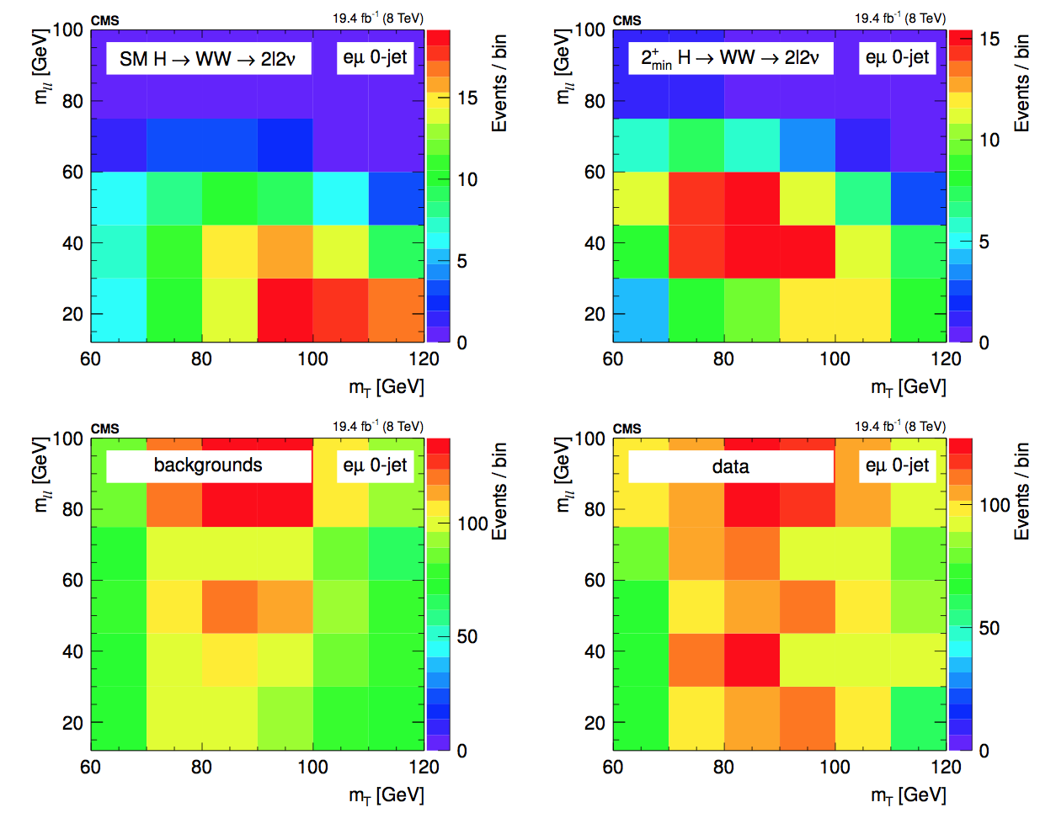
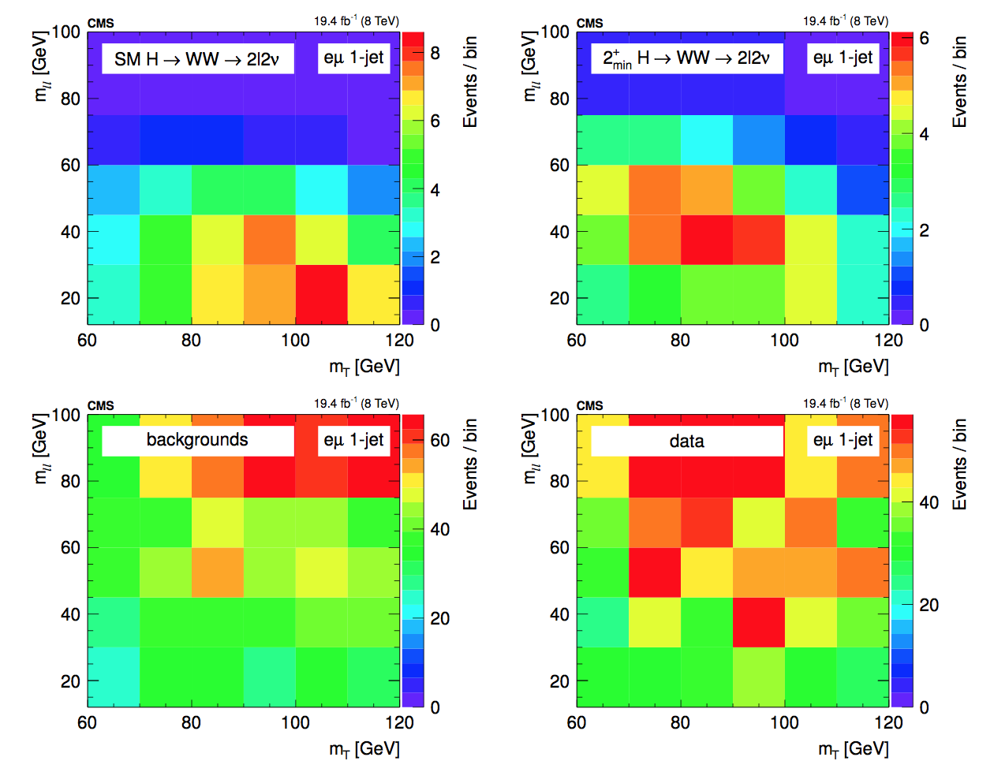
2D templates
A binned template fit is performed to extract upper limits and significance

Slide 20
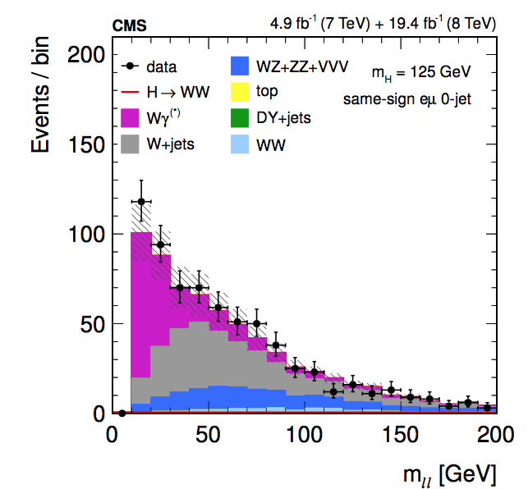
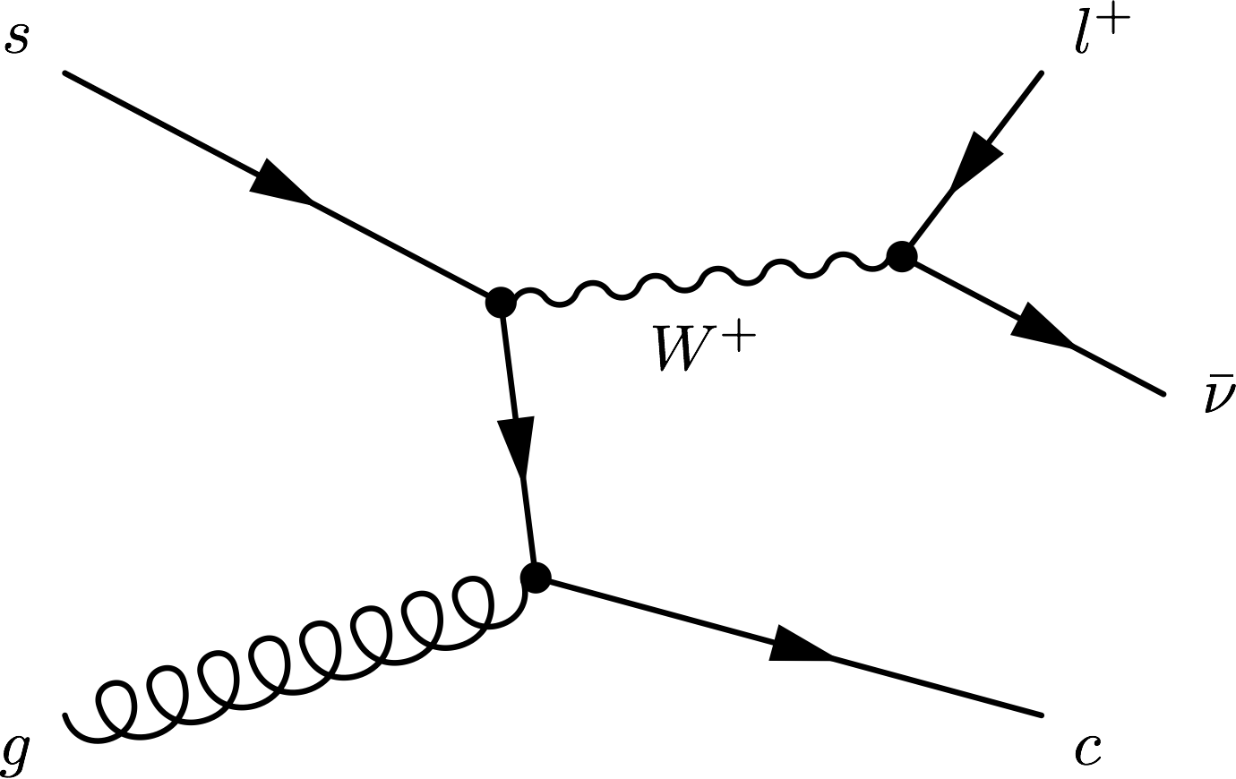
Background estimates
Central part of the analysis, data-driven as much as possible
Non-prompt leptons (W+jets, QCD): Leptonic decays of heavy quarks, hadrons misidentified as leptons, electrons from photon conversions.
Fully data-driven: normalization and shapes
Pass-fail sample reweighed by pass efficiency estimated in data (multijet)
Closure test in simulation, validated in same-sign region (dominated by W+jets and Wγ(∗) )
Potential “fake” lepton

Slide 21
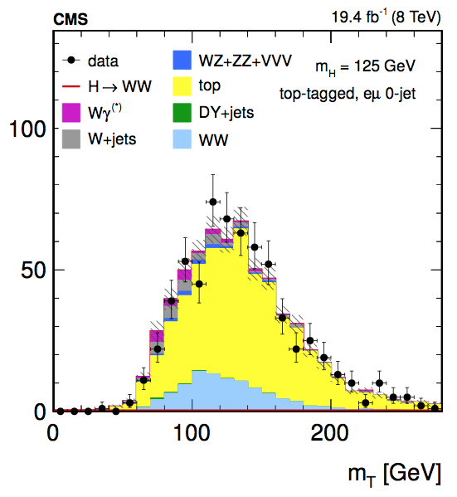
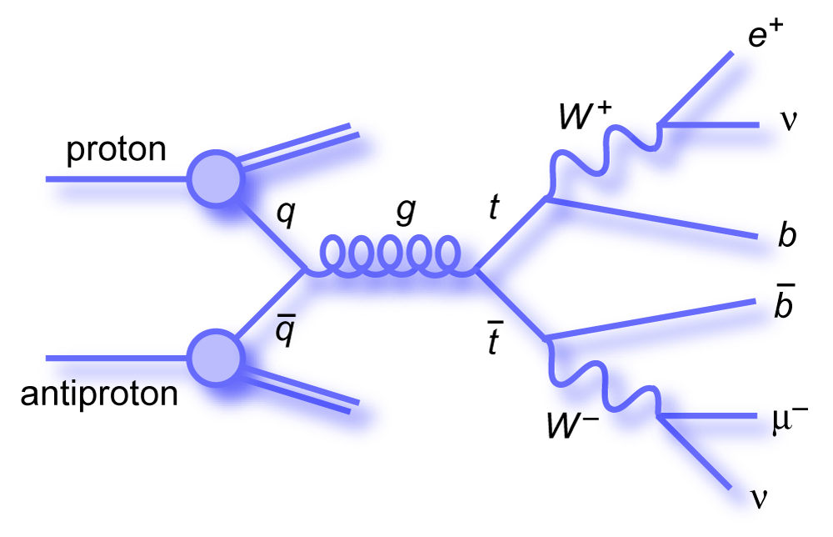
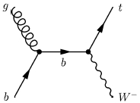
Background estimates
Top: Events from ttbar and single top tW
Shapes from simulation, normalization from data
Using top tagged events (rejected in the analysis) reweighted by efficiency measured in CR, defined using additional jets (1j in 0j, 2j in 1j)
Fit validated using top tagged events

Slide 22
Background estimates
Drell-Yan: in same flavor final states
shapes from simulation, normalization from data around the Z mass peak
Wγ*: shape from simulation, normalization from data
part of WZ not properly modeled in MC → low m_{ll} events where 1 lepton is lost (too soft)
simulated sampled compared with data in CR defined by different cuts (k-factor obtained)
Wγ: shape from data, normalization from simulation
data γ+lepton events reweighed with ratio γ->lepton
WZ,ZZ,VVV: simulation

Slide 23
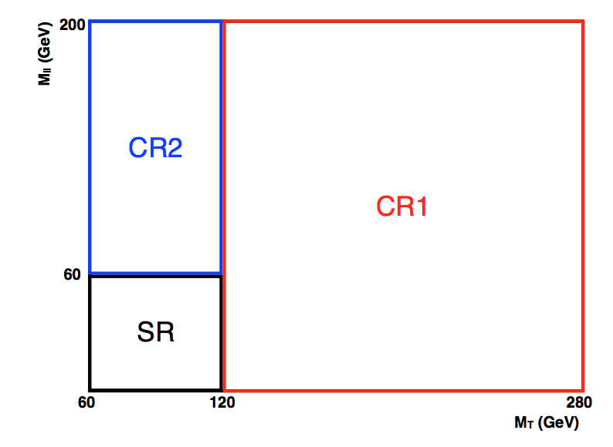
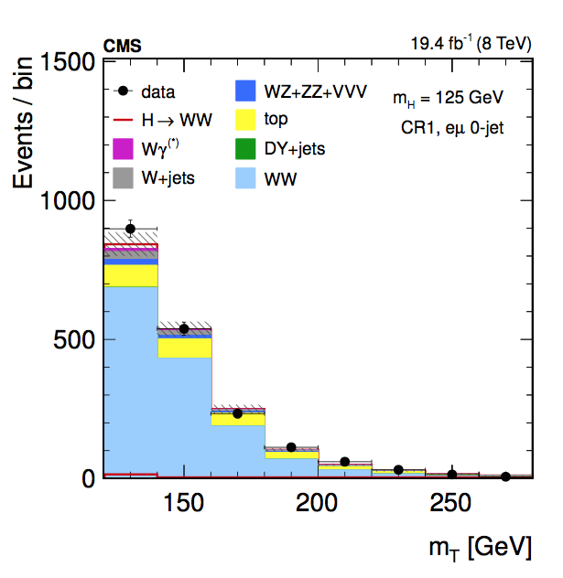
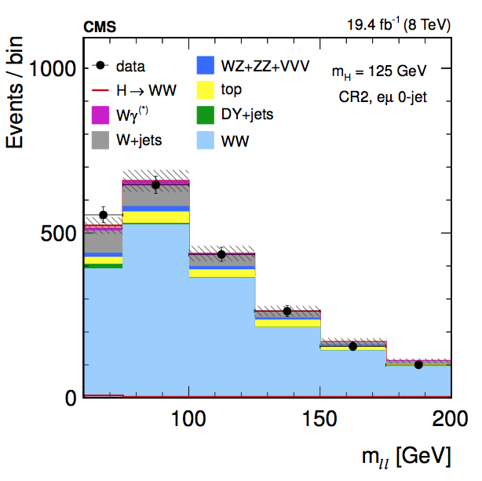
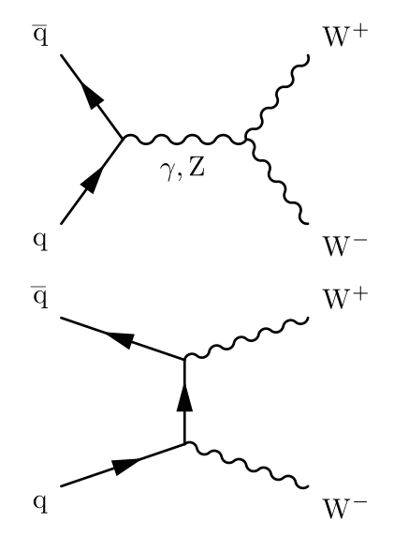
WW Background
Fit validated in two control regions, similar statistics, purity 70-75%
output of fit in one extrapolated to the other:
high m_{T} CR1: 120 < m_{T} < 280 and 12 < m_{ll} < 200
high m_{ll} CR2: 60 < m_{T} < 120 and 60 < m_{ll} < 200

Slide 24
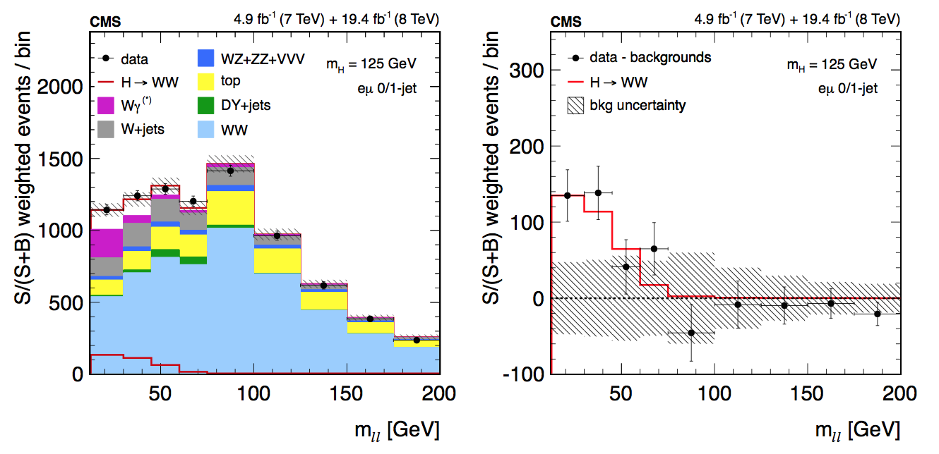
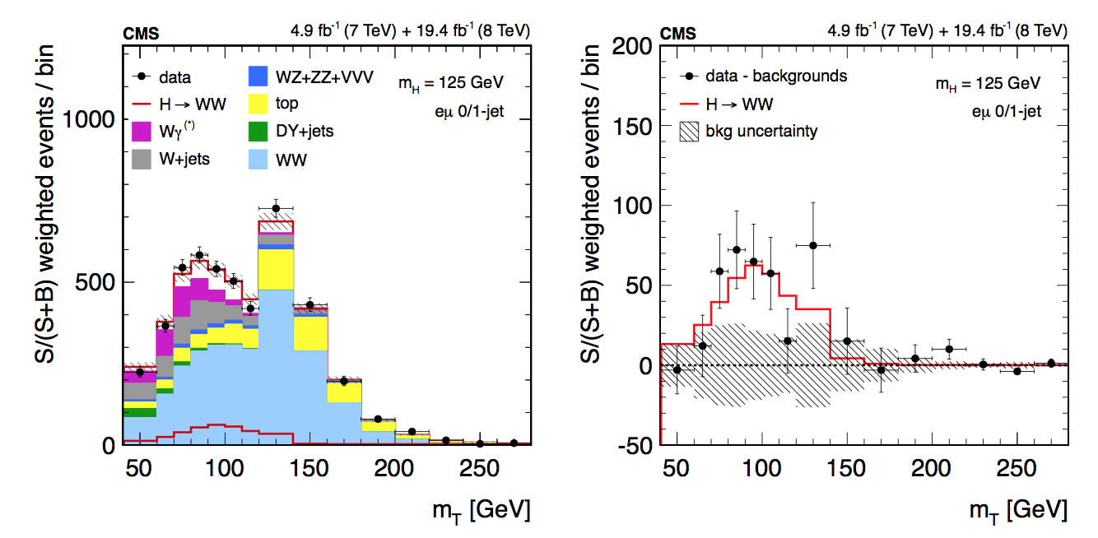
Final distributions
Data compared with signal and background events
Background-subtracted data compared with best-fit signal component

Slide 25
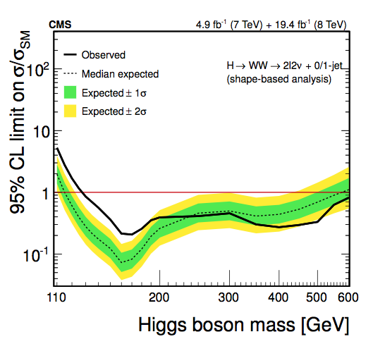
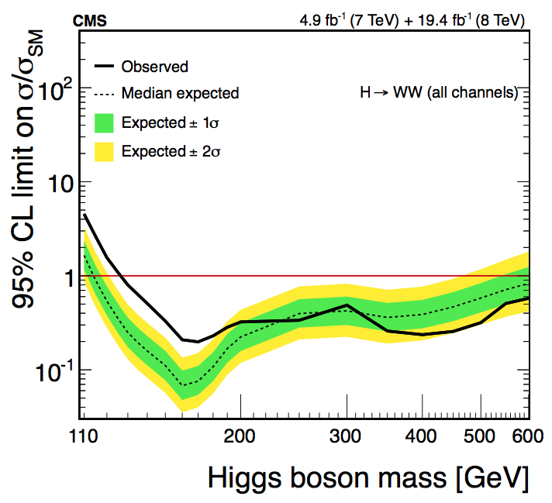
Results
The eµ channel alone:
95% CL |  | Significance |  | σ/σ_{SM}
Exp. | Obs. | Exp. | Obs.
0.4 | 1.2 | 5.2 | 4.0 | 0.76±0.21
Full H→WW result
Significance |  | σ/σ_{SM}
Exp. | Obs.
5.8 | 4.3 | 0.72+0.20-0.18

Slide 26



There is something
Something that decays via X→WW→2l2ν
There is confirmation from other decays (in some decays stronger than in WW, in other decays less so)
But is it the Higgs?
Handles to find deviations with respect to the SM expectations:
Mass, Charge, Spin, Parity…
→ How much can we explore using H→WW?
SM prediction
Reality?
Reality?

Slide 27
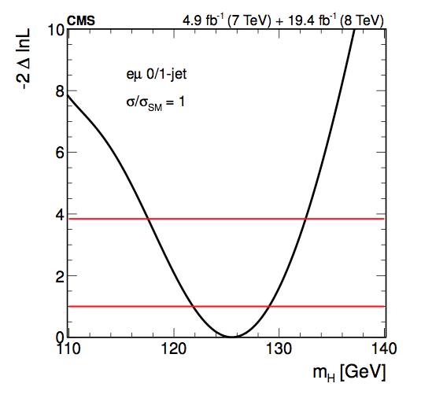
Charge
The charge is 0, it is a neutral particle.
The H→WW excludes a Higgs mass range from 127 to 600 GeV
Expected range extends from 115 to 600 GeV→ Additional Higgs bosons excluded in 114–600 GeV
Best-fit mass:
σ/σ_{SM}=1, m_{H} = 125.5+3.6−3.8 GeV
Without constraints, m_{H} = 128.2±6.6 GeV
Mass
CMS Higgs mass value (driven by γγ and ZZ):
m_{H} = 125.02 +0.26-0.27 (stat) +0.14-0.15 (syst)
arXiv:1412.8662
Eur. Phys. J. C (2015) 75:212
Dec 2014

Slide 28
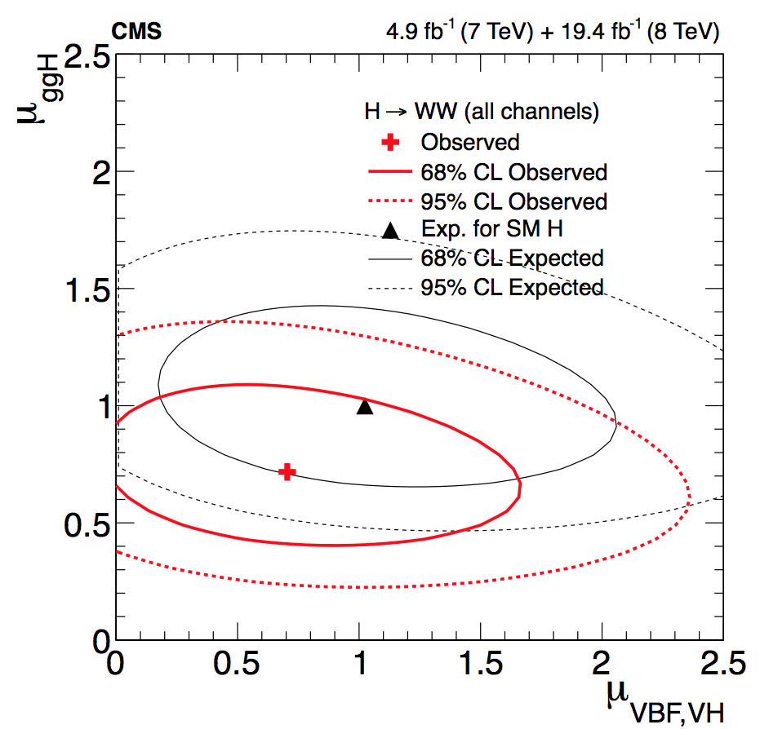
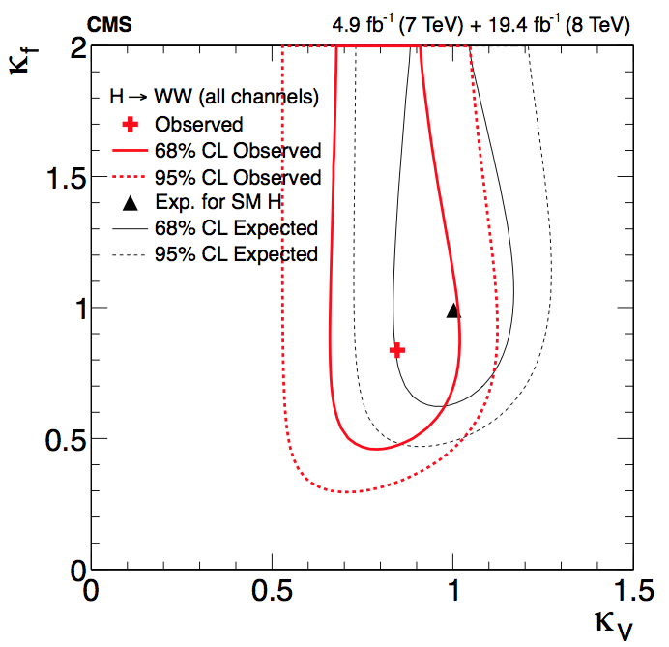
Couplings
The values of µ_{ggH} and µ_{VBF} can be used to test the fermionic and bosonic couplings assigning coupling modifiers κ_{V} and κ_{f} to vector and fermion vertices → used to scale the expected product of σxBR to match the signal yields in data
κ_{i} is κ_{f} for ggH, κ_{V} for VBF; and κ_{H} is the total decay width ~ κ_{f}²
µ_{ggH} is sensitive to κ_{V} and µ_{VBF}, which scales with κ_{V}⁴/κ_{f}² is more sensitive to κ_{f}

Slide 29
Spin and parity
arXiv:1411.3441
Phys. Rev. D 92, 012004
November 2014
Information from angular distributions of the decay products:
For example, in H→ZZ→4l, the final state is reconstructed fully and accurately
In H→WW the final state is not fully reconstructed, and there is more background contamination in the signal region, however
There is potential gain in the combination of HWW with other final states
We extract all the possible information using the same templates used for the SM Higgs search
Interpretation of the signal events in terms of
Hypothesis test of SM against exotic spin-1 and spin-2 Higgs boson, using the same model as in the SM Higgs search and the test statistic q = -2ln(L_{JP}/L₀₊) to quantify the consistency of the two models with data
Anomalous couplings with respect to SM of a spin-0 Higgs boson using fractions of cross sections

Slide 30
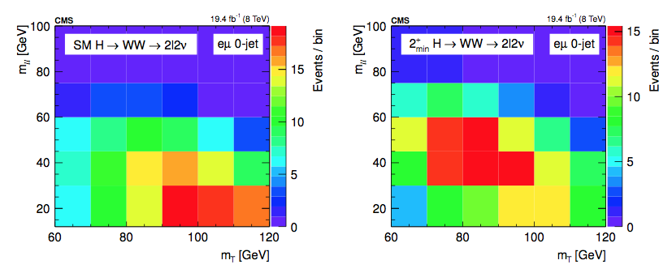
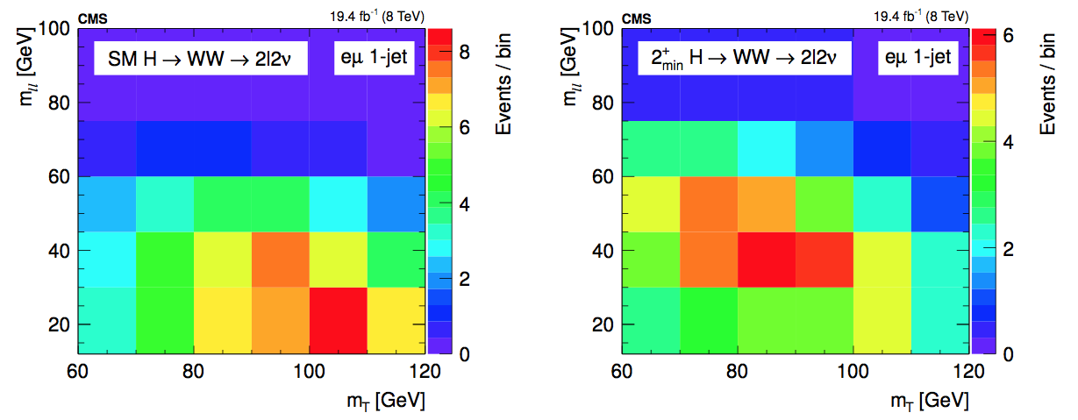
Spin studies in H→WW
The same 2D templates used in the eµ analysis are also optimal to discriminate between different spin hypotheses

Slide 31
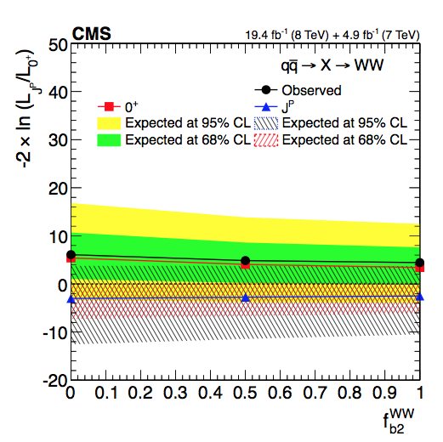
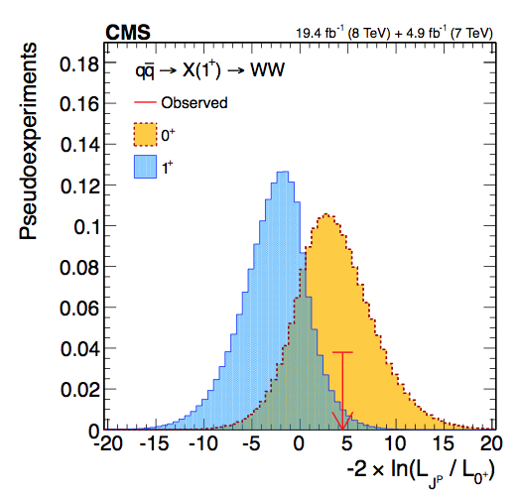
Spin-1
J=1 not allowed for X→𝛾𝛾 by the Landau-Yang theorem
Still we tested experimentally potential spin-1 models (in the hypothesis the excess is not the same resonance as 𝛾𝛾) in H→WW: J^{P}=1⁻, 1⁺ and a mixed case

Slide 32
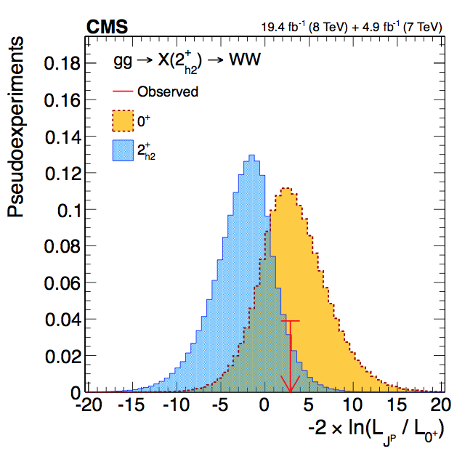
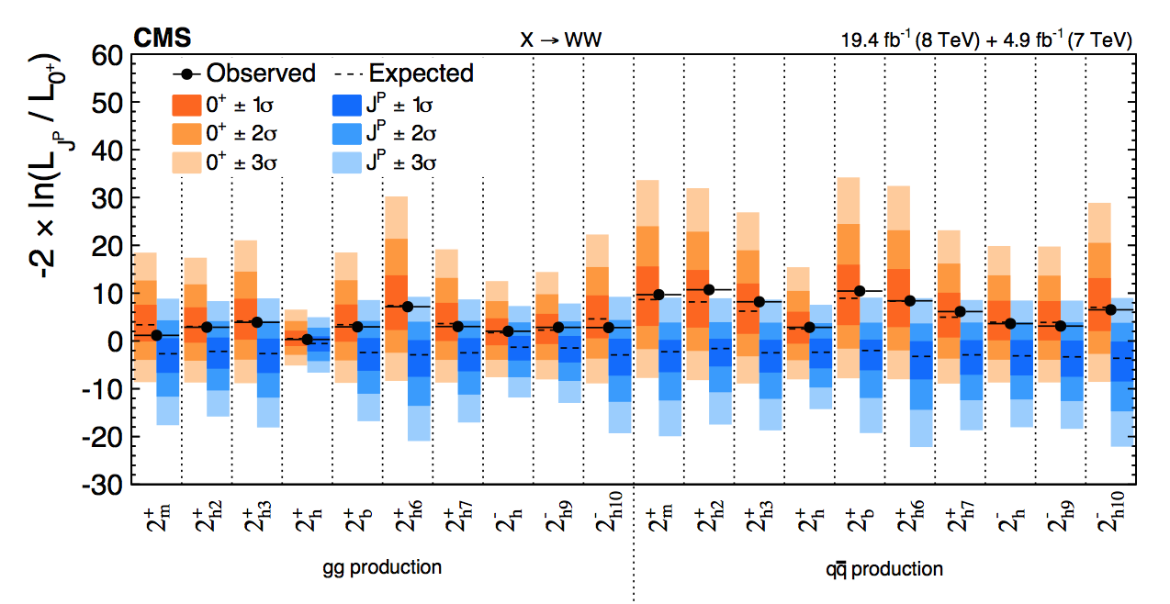

Spin-2
J=2 tested for different production modes (gg, qq), ten different models tested, separation studied as a function of the qqH component, f_{qq}
In all cases the data favor the SM hypothesis over the alternative spin-one or spin-two hypotheses

Slide 33

Better together
The main player in separating exotic spin hypotheses is the H→ZZ decay, but H→WW contributes to the combination
All the exotic models are excluded at more than 99.9% CL
(It is a spin 0 boson)

Slide 34

Spin 0 amplitude in H→VV
The observed Higgs boson appears to be predominantly a J^{CP}=0⁺⁺ state
It still could be a mixture of CP states and the couplings to gauge bosons could have small anomalous components
The decay amplitude for a spin-0 boson to a pair of V bosons (V = Z, W, g, γ) is defined, up to dimension 5, as:
a1 is the SM amplitude
Λ1 is a higher-term of an expansion in momentum
a2 and a3 control the CP-even and CP-odd amplitudes

Slide 35


Spin 0 amplitude in H→VV
We choose a parameterization that relates fractions of the cross sections to the couplings: f_{a2}, f_{a3}, f_{Λ1}
Given the measured value of f_{x}, it is possible to extract the coupling constant:
Where f_{a1} = 1-f_{a2}-f_{a3}-f_{Λ1}-…, is the SM contribution, which is expected to dominate
σ_{i} is the effective cross-section when a_{i} = 1 and a_{j≠I} = 0

Slide 36




H→WW Spin-0 studies
We perform likelihood scans for the effective fractions using pure SM templates together with f_{i} =1, mixed scenarios, and data
Everything is consistent with the SM
H→WW has limited sensitivity for the measurement of f_{a2}, f_{a3} and f_{Λ1}
Couplings constrained to be real and all other anomalous couplings are fixed to the SM predictions in each case, cos φ term allows signed quantity: cos φ = −1 (π), +1 (0)

Slide 37

H→WW and H→ZZ combination
Again H→ZZ drives the sensitivity in this kind of measurements, but in general, and in particular under certain assumptions (namely custodial symmetry between HZZ and HWW, that correlates the yields), the combination of H→ZZ and H→WW results provides improved sensitivity
Summary of allowed confidence level intervals on anomalous coupling parameters in HVV interactions under the assumption that all the coupling ratios are real → compatible with a SM Higgs

Slide 38

So, it is the Higgs?
We have a new particle that decays like the SM Higgs would
With a mass ~ 125GeV
Neutral
Scalar couplings to fermions and vector bosons compatible with a SM Higgs
J^{CP}=0⁺⁺
Is this guy exactly as we expect it?
Looks like it is from here

Slide 39

But only more data will tell

